Slide 1
Live Session 6
By Ben Goodwin

Slide 2
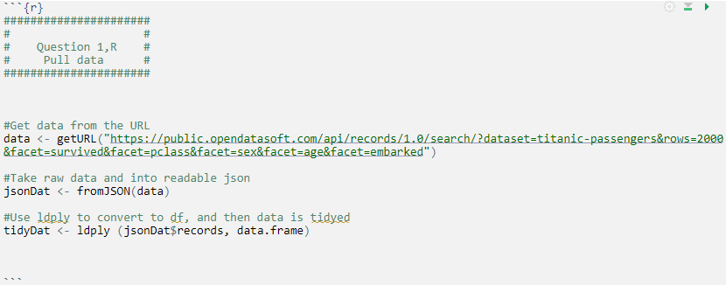
Question 1, Titanic Dataset
R input to read json data:
Libraries:
Rcurl (to fetch url data)
jsonDat (to make json data useable)
Plyr (to take records from json list to data frame)

Slide 3
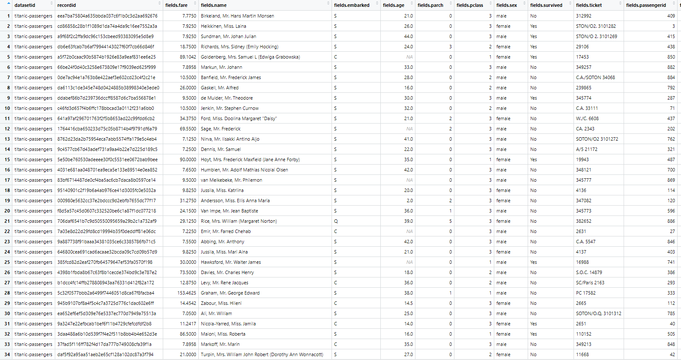
Question 1, Titanic Dataset
Extracted Data Frame:
891 Records each with 15 records

Slide 4
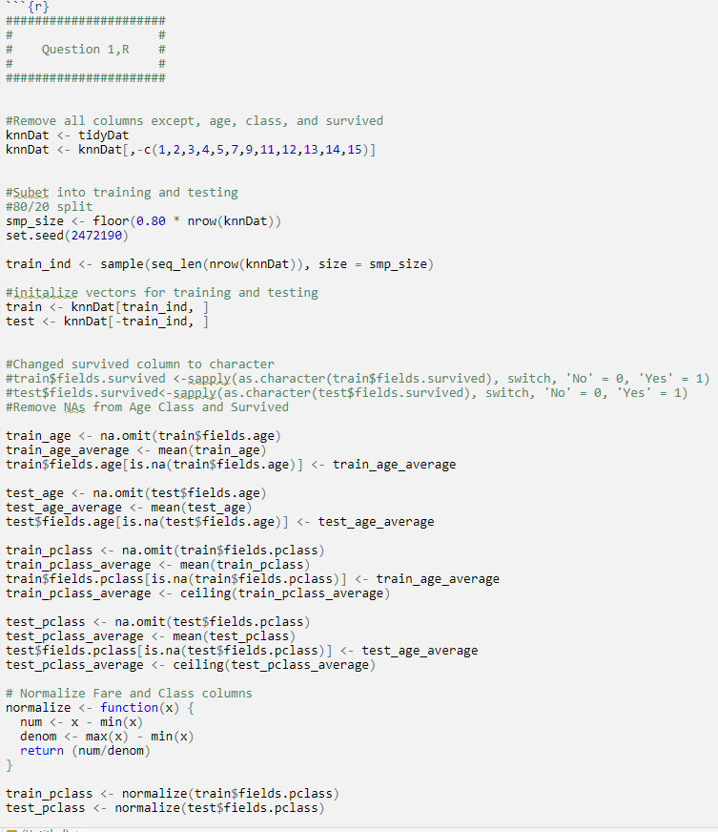
Question 2, Titanic Dataset
KNN classification Data preparation (R input):
Steps
Remove unnecessary columns
Split training and test data
Prepare variables for KNN
Remove NAs
Fill in NAs with averages
Normalize to help with KNN fit
Run KNN

Slide 5
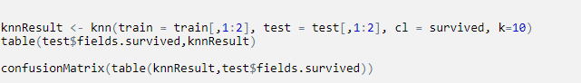
Question 2, Titanic Dataset
KNN(R input):
K=10 appears to be optimal.

Slide 6
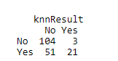
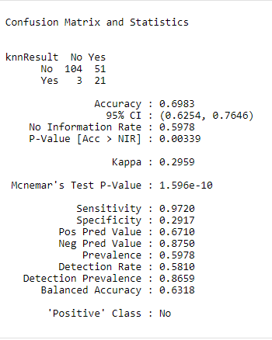
Question 2, Titanic Dataset
KNN Results
Confusion matrix

Slide 7
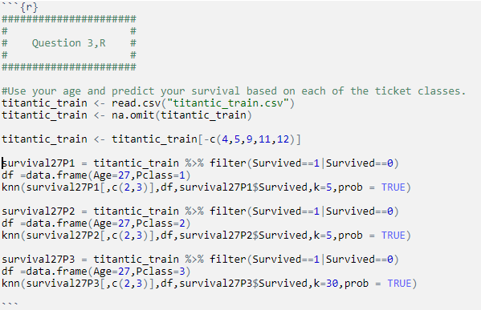
Question 3, Titanic Dataset
R input to predict based on age 27 and different classes

Slide 8
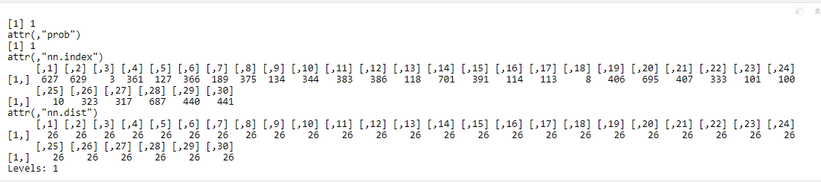
Question 3, Titanic Dataset
R output to predictions based on age 27 and different classes
Issues are clearly present, each level reporting probability of survival of 1 based on age and class

Slide 9
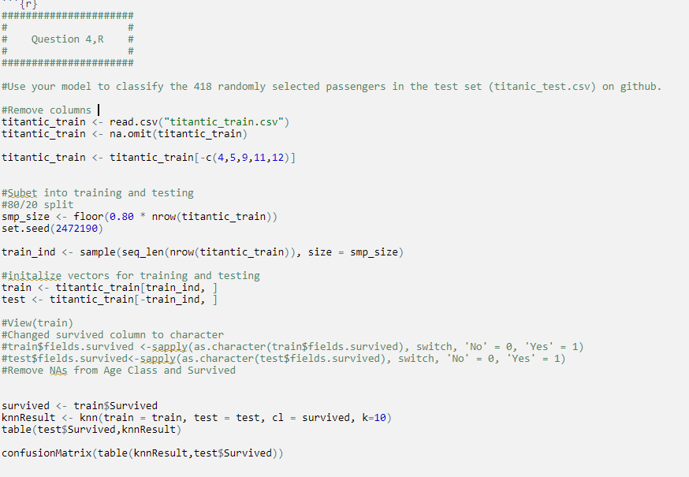
Question 4, Titanic Dataset
R input for classification of 418 passengers:

Slide 10
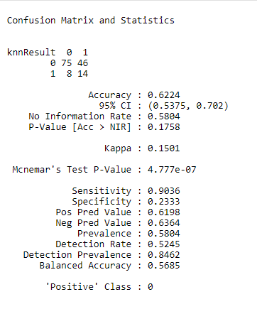
Question 4, Titanic Dataset
R ouput for classification of 418 passengers:

Slide 11
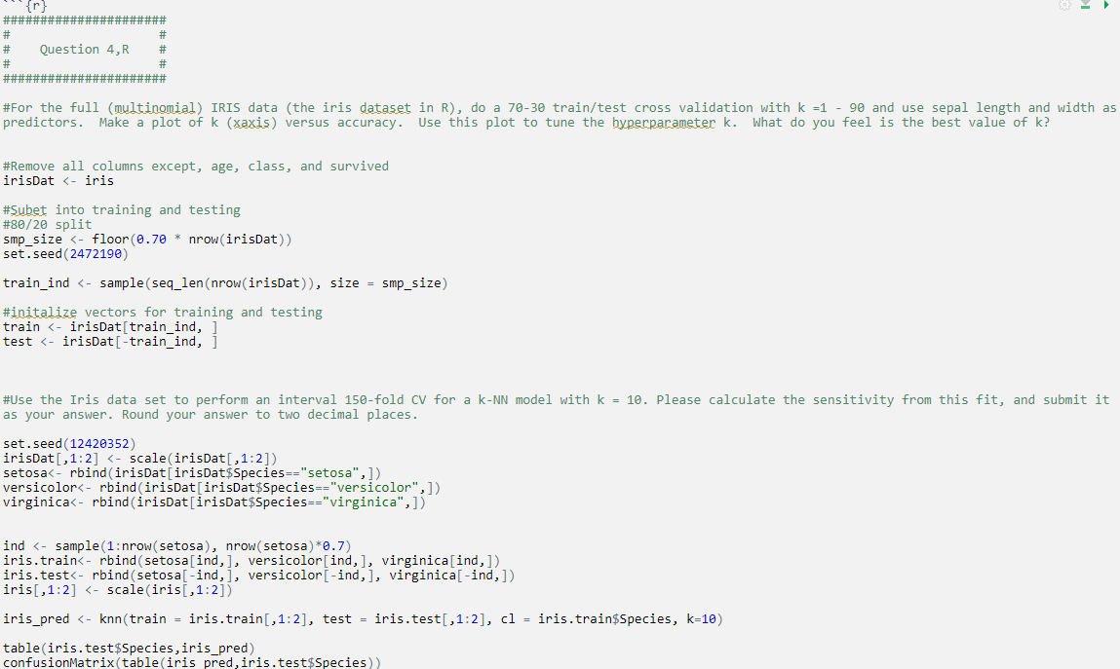
Part 2, Iris Dataset
R input for Iris data:

Slide 12
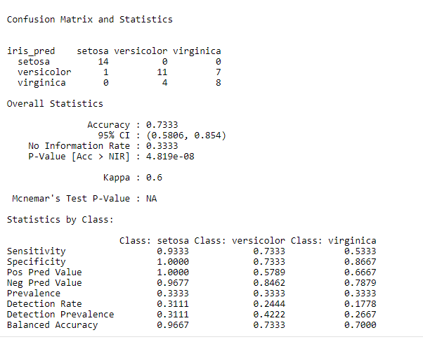
Part 2, Iris Dataset
R output for Iris data:

Slide 13
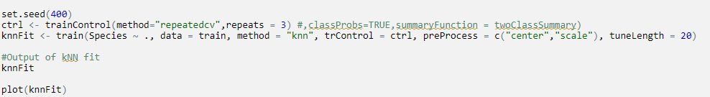
Part 2, Iris Dataset
R output for Iris data tuning code:

Slide 14
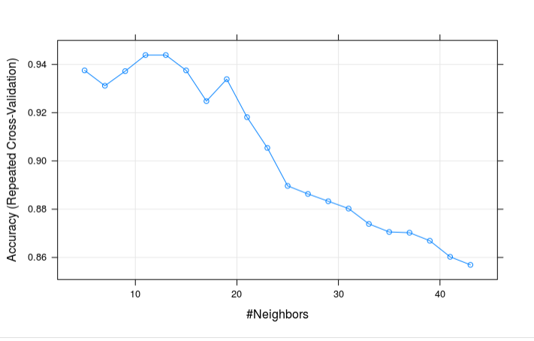
Part 2, Iris Dataset
R output for Iris data tuning code:
It looks like accuracy peaks around k=12 and drops off after.

Slide 15
Takeaways!
I found this live session difficult!
Predicting groups based on KNN was very challenging and I’m not sure I did it correctly.
KNN was a good starting point as in smaller datasets it can be calculated by hand.
This was great R practice, and I was introduced to lots of good packages.
Machine learning is an interesting topic and I can’t wait to learn more techniques!

